Slide 1

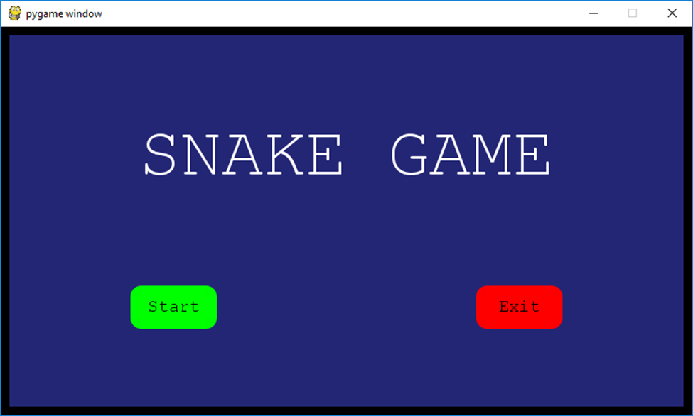
Snake Game
Developers : Nixon Jovin & Joshua Sowemimo original Developer: Alexander
Creating a snake game that includes music that the whole family can play

